Slide 1


ALY 6080 Final-XN ProJECT PRESENTATION
Presented By
Adyant Tripathy
Akshay Vibhute
Jai Sunil Thombre
Linke Yuan
Sindhu Sundararajan

Slide 2

CONTENTS
Executive Summary
Business Problem
Analysis and Visuals
Clear Concise Flow
Analysis and synthesis of the data
Recommendations
Future Research

Slide 3

EXECUTIVE SUMMARY
The Los Angeles Center of Photography (LACP) Portfolio Review Session Data Analytics Project aims to enhance the overall experience for photographers participating in portfolio evaluations. By leveraging data analytics, the project seeks to gain insights, identify patterns, and make data-driven improvements to the review sessions. The project follows a systematic approach, including data collection, cleaning, exploratory data analysis, feature engineering, model selection, model evaluation, and deriving insights and recommendations

Slide 4


BUSINESS PROBLEM
The Los Angeles Center of Photography (LACP) aims to foster and advance the practice of photography by offering portfolio review sessions to up-and-coming photographers. However, the current portfolio review process lacks efficiency, leading to suboptimal experiences for both participants and reviewers. This inefficiency hampers the center's ability to provide valuable feedback, hinder participants' growth, and limit the overall success of the events.The business problem lies in the lack of a systematic and data-driven approach to portfolio reviews. Without a structured process for collecting and analyzing data, the center cannot effectively evaluate the effectiveness of the sessions, identify areas for improvement, or make informed decisions to enhance the overall experience.

Slide 5

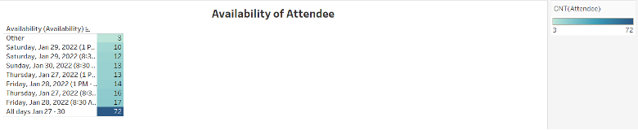
ANALYSIS AND VISUALS
The table provided presents the availability of slots and the corresponding number of attendees who participated in these slots. It is worth noting that the slot with the highest attendance was "Friday, January 28, 2022, at 8:30 AM," which was chosen by a total of 72 attendees.

Slide 6
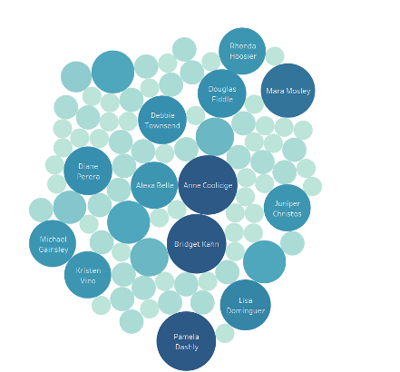

ANALYSIS AND VISUALS
The graph provided displays the names of attendees and the respective number of sessions they attended. A noteworthy observation is that Anne Coolidge, Bridget Kahn, and Pamela Dashly all attended an equal number of sessions, specifically 48. Additionally, Mara Mosley attended a total of 40 sessions.

Slide 7
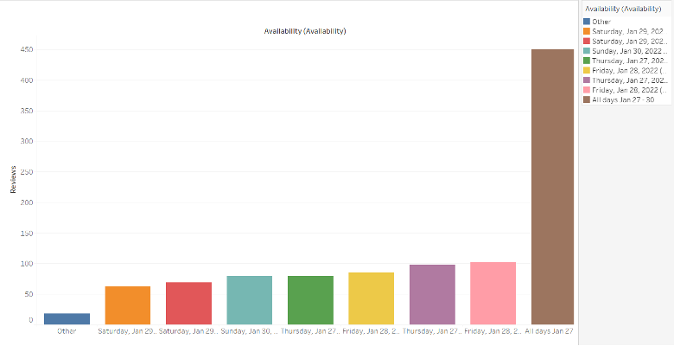
ANALYSIS AND VISUALS
The heatmap reveals instances where participants selected between 5 and 8 reviewers. Notably, Sean Deangeio stands out by opting for 13 reviewers, indicating a noteworthy decision.

Slide 8
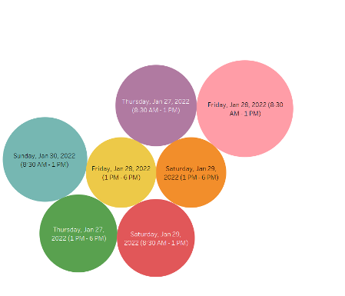
ANALYSIS AND VISUALS
According to the data, the time slot with the highest availability of reviewers was on Friday, January 28, 2022, from 8:30 AM to 1 PM. This indicates that during this period, there were a greater number of reviewers who were able and willing to participate in the reviewing process. The exact number of available reviewers is not specified in the given information.

Slide 9
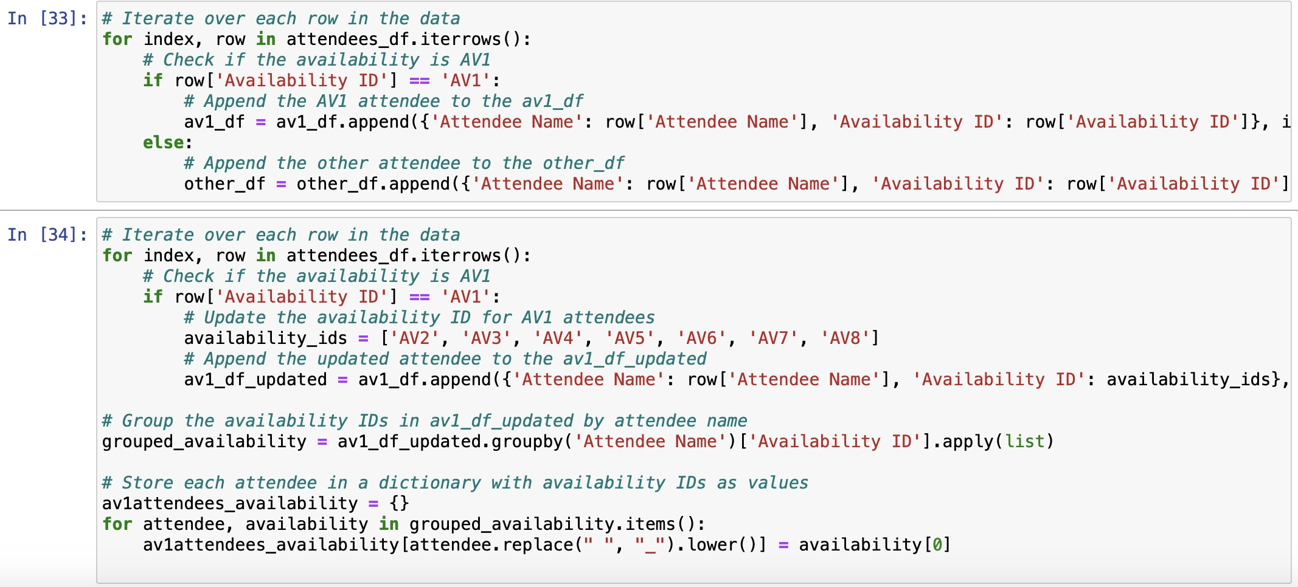
code implementation

Slide 10
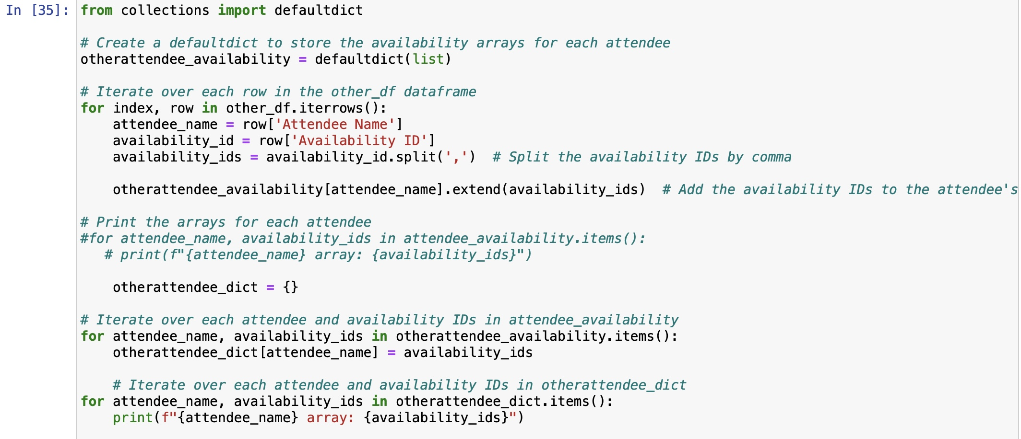
code implementation

Slide 11
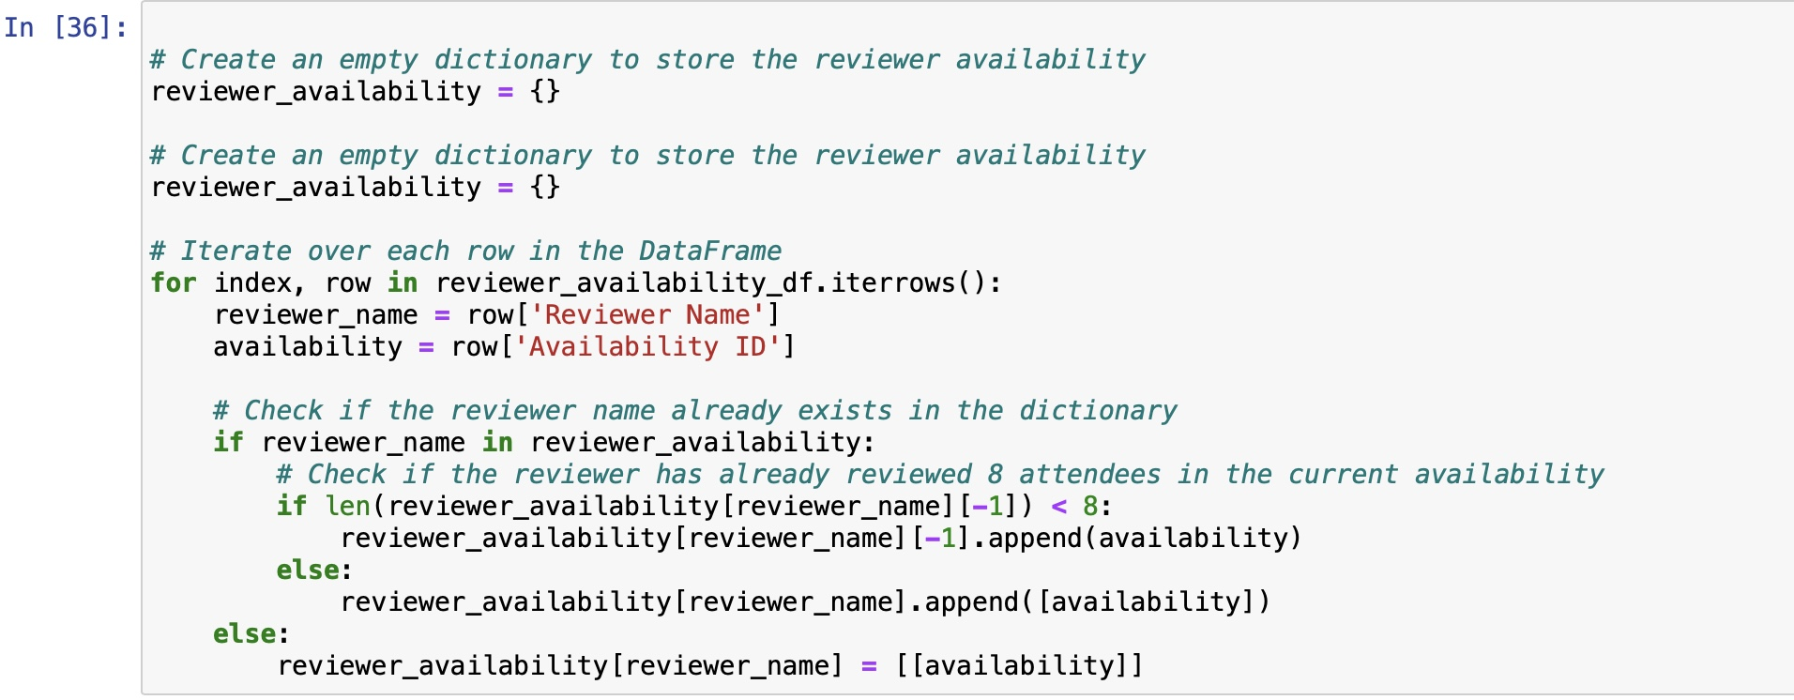
code implementation

Slide 12
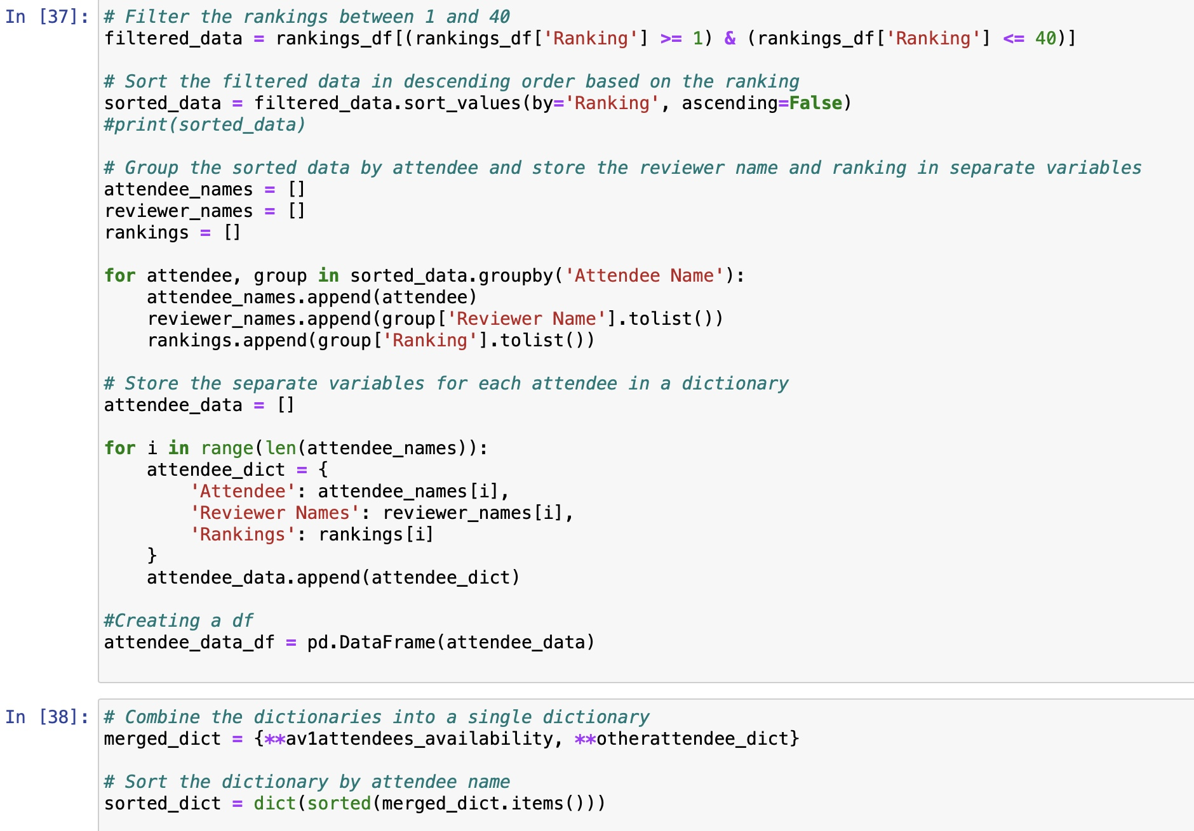
code implementation

Slide 13
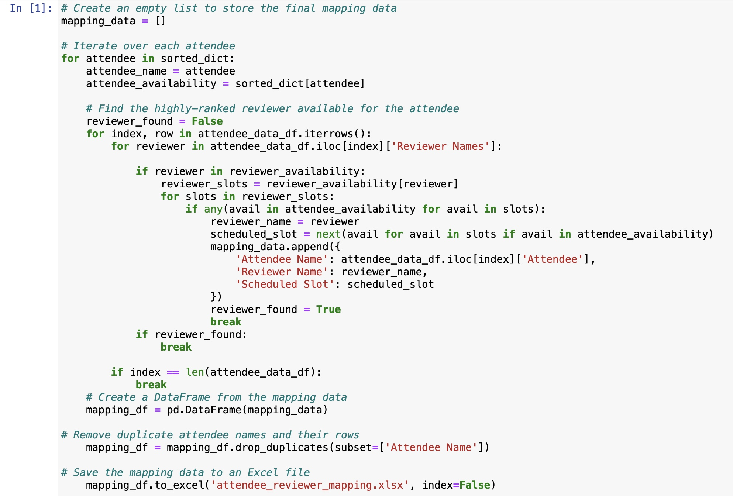
code implementation

Slide 14
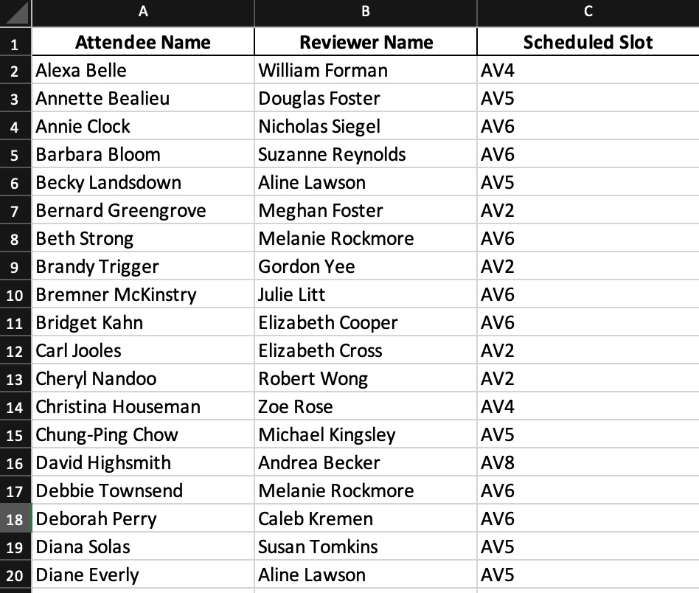
EXPECTED OUTPUT

Slide 15

CLEAR CONCISE FLOW
Identify the Current State
Define Objectives
Develop a Data Collection Framework
Analyze and Generate Insights
Implement Data-Driven Improvements
Monitor and Evaluate
Iterative Enhancement

Slide 16
ANALYSIS AND SYNTHESIS OF THE DATA
Quantitative Analysis : Apply quantitative analysis techniques to identify patterns, trends, and statistical insights within the data. Conduct statistical calculations, such as averages, percentages, and correlations, to derive meaningful conclusions.
Synthesis and Interpretation: Look for connections between the quantitative metrics and the qualitative insights to create a holistic view of the portfolio review sessions. Identify strengths, weaknesses, and areas for improvement based on the analysis .
Generate Actionable Recommendations: Prioritize the recommendations based on their potential impact and feasibility of implementation. Ensure the recommendations align with the objectives of the portfolio review sessions and address the identified inefficiencies.
Seek Feedback and Validation : By conducting thorough analysis and synthesis of the data, the Los Angeles Center of Photography can gain valuable insights into the portfolio review sessions and make informed decisions for improving the process and enhancing participant experiences.

Slide 17

RECOMMENDATIONS
Improve Reviewer Training: : Provide comprehensive training to portfolio reviewers to ensure consistent evaluation standards and effective feedback delivery. Include sessions on providing constructive criticism, identifying strengths and weaknesses, and offering actionable suggestions for improvement.
Enhance Participant Preparation: Offer pre-review workshops or resources to help participants better prepare their portfolios. Provide guidance on portfolio organization, presentation, and storytelling to maximize the impact of their work.
Diversify Reviewer Pool: Expand the pool of portfolio reviewers to include professionals from diverse backgrounds and specialties. This will provide participants with a wider range of perspectives and feedback, enriching their experience.

Slide 18
FUTURE RESEARCH
Long-term impact: Conduct a longitudinal study to evaluate the long-term impact of portfolio review sessions on participants' careers and artistic development. This could involve tracking participants' progress, achievements, and professional growth over several years.
Comparative Analysis: Compare the effectiveness and outcomes of portfolio review sessions at LACP with similar programs offered by other photography organizations or institutions. This analysis can help identify best practices and areas for improvement.
Participant Feedback Analysis: Conduct in-depth qualitative research by interviewing past participants to gain deeper insights into their experiences, perceived benefits, and suggestions for further improvement. This feedback can provide valuable information to refine the program.
Reviewer Training Evaluation: Assess the effectiveness of the reviewer training program by gathering feedback from both reviewers and participants. Evaluate the impact of training on the quality and consistency of feedback provided, as well as reviewer satisfaction.
Diversity and Inclusion Impact: Investigate the impact of having a diverse pool of reviewers on participant experiences and outcomes. Explore whether diverse perspectives lead to more comprehensive feedback and greater opportunities for participants from underrepresented groups.

Slide 19

OTHER RELEVANT INFORMATION
Algorithms for Attendee-Reviewer Matching:
* Discuss briefly the algorithms investigated for attendee-reviewer matching:
* Priority-based matching: Give participants' top-ranked reviews a higher priority.
* Algorithm-based scheduling: Use algorithms to efficiently allocate reviewers depending on availability and preferences.
* Time slot management: To meet participant availability, balance the allocation of reviewers among AM and PM sessions.

Slide 20

CONCLUSION
Program Expansion Assessment: Evaluate the feasibility and impact of expanding the portfolio review sessions to additional locations or online platforms. Assess the potential benefits and challenges of reaching a broader audience and accommodating remote participation.
Participant Motivations and Goals: Conduct research to understand the motivations and goals of participants attending portfolio review sessions. Identify common themes, aspirations, and specific objectives that participants aim to achieve through the program.

Slide 21
REFERENCE
Tichy, M., & Tichy, M. (2013). A competence portfolio for professionals in the creative industries. International Journal of Arts Management, 15(3), 18-29 https://www.researchgate.net/publication/256057305_A_Competence_Portfolio_for_Professionals_in_the_Creative_Industries
Bai, H., & Li, W. (2016). Effect of feedback on creativity in social learning contexts. Thinking Skills and Creativity, 21, 1-9. doi 10.1016/j.tsc.2016.05.001
https://www.researchgate.net/publication/283774670_Effect_of_Feedback_on_Creativity_in_Social_Learning_Contexts
Shepherd, C. E. (2011). The effects of electronic portfolio tools on online students' perceived support and cognitive load. The Internet and Higher Education, 142-149. https://doi.org/10.1016/j.iheduc.2011.01.002
Ray, M. E. (2020). Leveraging a required e-portfolio course to meet multiple needs: Student assessment, curriculum improvement, and accreditation. Currents in Pharmacy Teaching and Learning, 1437-1446. https://doi.org/10.1016/j.cptl.2020.07.004

